Slide 1
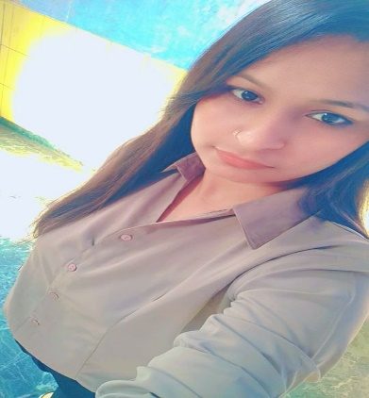



Ruchi
Maurya
Full-stack Developer
(Java Technology)
PROFILE
EDUCATION
Accounting student.
I consider myself a responsible and orderly person.
I am looking forward to my first work experience.
Gujarat University
Master of commerce
2020-2023
LANGUAGE
English
Gujarati
Hindi
CONTACT ME
TECHNOLOGY SKILL
6355130590
HTML
CSS
SQL
JAVASCRIPT
REACT.JS
REDUX
Core Java
+
ruchimaurya84138@gmail.com
https://github.com/Ruchimaurya11

